Slide 1
Fall, 2021
Lecture 01: Limits and Continuity

Slide 2
Contents
1
Definition of Limit of a function
2
Properties of Limits
3
Indeterminate form and Limit at infinity
4
One-sided Limits
5
Continuity of a function

Slide 3
LIMITS

Slide 4

Limits by example : A speeding train
From data obtained in a test run conducted on a prototype of train, which moves along a straight monorail track, engineers have determined that the position of the train (in feet) from the origin at time t is given by:
Where f is called the position function of the train.
The position of the train at time t = 0, 1, 2, 3, … , 10 is
f(0) = 0 f(1) = 4 f(2) = 16 f(3) = 36 … f(10) = 400
But what if we want to find the velocity of the train at any given point in time?
$$s=f\left(t\right)={4t}^{2} (0≤t≤30)$$

Slide 5
Limits by example : A speeding train
Say we want to find the instant velocity of the train at t = 2.
We may compute the average velocity of the train over an interval of time, such as [2, 4] as follows:
It is not the velocity of the train at t=2, but it is a useful approximation.
We may find a better approximation by choosing a smaller interval to compute the speed, for example [2,3]. More generally, let t>2 then the average velocity of the train over the time interval [2,t] is given by:
$$\frac{Distance covered}{Time elapsed}=\frac{f\left(4\right)−f(2)}{4−2}=\frac{4{(4)}^{2}−4{(2)}^{2}}{4−2}=\frac{64−16}{2}=24(\frac{feet}{s})$$
$$\frac{Distance covered}{Time elapsed}=\frac{f\left(t\right)−f(2)}{t−2}=\frac{4t^{2}−4{(2)}^{2}}{t−2}=\frac{4{(t}^{2}−4)}{t−2}$$

Slide 6
Limits by example : A speeding train
$$\frac{Distance covered}{Time elapsed}=\frac{4{(t}^{2}−4)}{t−2}$$
By choosing the values of t closer and closer to 2, we obtain average velocities of the train over smaller and smaller time intervals.
The smaller the time interval, the closer the average velocity becomes to the instantaneous velocity of the train at t = 2, as the table below demonstrates:
The closer t gets to 2, the closer the average velocity gets to 16 feet/second.
Thus, the instantaneous velocity at t = 2 seems to be 16 feet/second.
t | 2.5 | 2.1 | 2.01 | 2.001 | 2.0001
Average Velocity | 18 | 16.4 | 16.04 | 16.004 | 16.0004

Slide 7
Definition of Limits
Consider function g, which gives the average velocity of the train:
Suppose we want to find the value that g(t) approaches as t approaches 2.
We take values of t approaching 2 from the right (as we did before), and we find that g(t) approaches 16:
Similarly, we take values of t approaching 2 from the left, and we find that g(t) also approaches 16:
$$g(t)=\frac{4{(t}^{2}−4)}{t−2}$$
t | 2.5 | 2.1 | 2.01 | 2.001 | 2.0001
g(t) | 18 | 16.4 | 16.04 | 16.004 | 16.0004
t | 1.5 | 1.9 | 1.99 | 1.999 | 1.9999
g(t) | 14 | 15.6 | 15.96 | 15.996 | 15.9996

Slide 8
Definition of Limits
We have found that as t approaches 2 from either side, g(t) approaches 16.
In this situation, we say that the limit of g(t) as t approaches 2 is 16.
This is written as:
Observe that t = 2 is not in the domain of g(t) .
But this does not matter, since t = 2 does not play any role in computing this limit.
$$\lim_{t→2}{g(t)}=\lim_{t→2}{\frac{4{(t}^{2}−4)}{t−2}=16}$$

Slide 9

Limit of a function
Limit (an informal view)
The function f has a limit L as x approaches a, written:
$$\lim_{x→a}{f(x)}=L$$
if the value of f(x) can be made as close to the number L as we please by taking x values sufficiently close to (but not equal to) a.

Slide 10



Limit of a function: Examples
Let . Evaluate
Solution: You can see in the graph that f(x) can be as close to 8 as we please by taking x sufficiently close to 2.
Therefore,
$$f\left(x\right)=x^{3}$$
$$\lim_{x→2}{f(x)}$$
y
f(x) = x³
8
6
4
2
– 2
$$\lim_{x→2}{f\left(x\right)=\lim_{x→2}{x^{3}}=8}$$
x
– 2 – 1 1 2 3

Slide 11


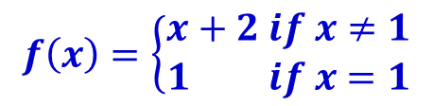
Limit of a function: Examples
$$f\left(x\right)=\left\{\begin{aligned}x+2 if x≠1 \\ 1 if x=1\end{aligned}\right.$$
Let .Evaluate
Solution: You can see in the graph that f(x) can be as close to 3 as we please by taking x sufficiently close to 1.
Therefore,
$$\lim_{x→1}{f(x)}$$
y
f(x)
5
3
1
$$\lim_{x→1}{f\left(x\right)=3}$$
x
– 2 – 1 1 2 3

Slide 12



Limit of a function: Examples
$$f\left(x\right)=\frac{1}{x^{2}}$$
Let .Evaluate
Solution: The graph shows us that as x approaches 0 from either side, f(x) increases without bound and thus does not approach any specific real number.
Thus, the limit of f(x) does not exist as x approaches 0.
$$\lim_{x→0}{f(x)}$$
y
$$f\left(x\right)=\frac{1}{x^{2}}$$
x
– 2 – 1 1 2

Slide 13
Properties of limits

Slide 14
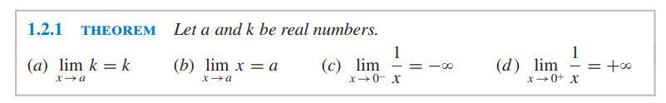
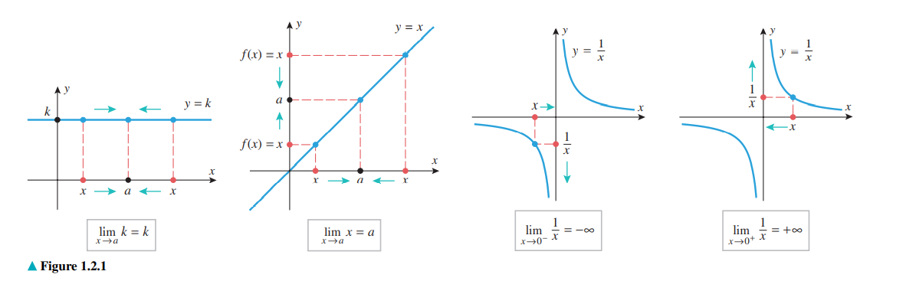
Theorem 1 : Properties of Limit

Slide 15
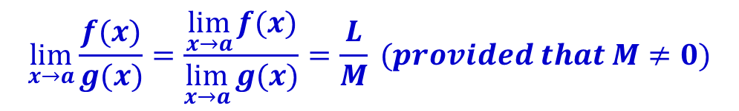



Theorem 2 : Properties of Limits
Suppose and
Then,
$$\lim_{x→a}{f(x)}=L$$
$$\lim_{x→a}{g(x)}=M$$
$$\lim_{x→a}{{\left[f(x)\right]}^{r}}={\left[\lim_{x→a}{f(x)}\right]}^{r}=L^{r}$$
$$\lim_{x→a}{cf(x)}=c\lim_{x→a}{f(x)}=cL$$
$$\lim_{x→a}\left[f(x)±g(x)\right]=\lim_{x→a}{f\left(x\right)±\lim_{x→a}{g(x)}}=L±M$$
$$\lim_{x→a}\left[f\left(x\right)g(x)\right]=\left[\lim_{x→a}{f(x)}\right]\left[\lim_{x→a}{g(x)}\right]=LM$$
$$\lim_{x→a}{\frac{f(x)}{g(x)}}=\frac{\lim_{x→a}{f(x)}}{\lim_{x→a}{g(x)}}=\frac{L}{M} (provided that M≠0)$$

Slide 16
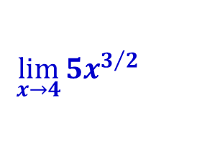




Theorem 1 and 2: Examples
Use theorem 1 to evaluate the following limits:
$$\lim_{x→2}{x^{3}}$$
$$\lim_{x→4}{{5x}^{3/2}}$$
$$\lim_{x→1}{{(5x}^{4}−2)}$$
$$\lim_{x→3}{{2x}^{3}\sqrt{x^{2}+7}}$$
$$\lim_{x→2}{\frac{2x^{2}+1}{x+1}}$$

Slide 17
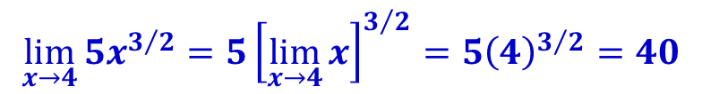
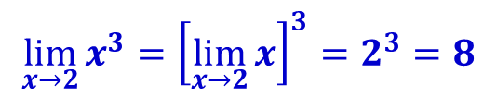
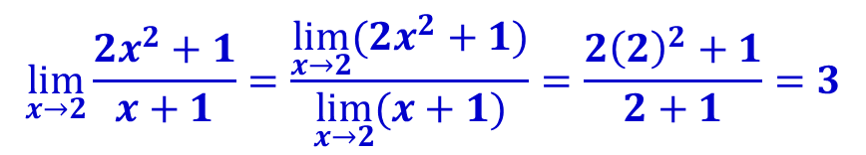
Theorem 1 and 2: Examples
Use theorem 1 to evaluate the following limits:
$$\lim_{x→2}{x^{3}={\left[\lim_{x→2}{x}\right]}^{3}=2^{3}=8}$$
$$\lim_{x→4}{{5x}^{3/2}=5{\left[\lim_{x→4}{x}\right]}^{3/2}=5{\left(4\right)}^{3/2}=40}$$
$$\lim_{x→1}{{(5x}^{4}−2)=\lim_{x→1}{5x^{4}−\lim_{x→1}{2}}=5{\left(1\right)}^{4}−2=3}$$
$$\lim_{x→3}{{2x}^{3}\sqrt{x^{2}+7}=\left[\lim_{x→3}{2x^{3}}\right]\left[\lim_{x→3}{\sqrt{x^{2}+7}}\right]=2{\left(3\right)}^{3}\sqrt{3^{2}+7}=216}$$
$$\lim_{x→2}{\frac{2x^{2}+1}{x+1}=\frac{\lim_{x→2}{(2x^{2}+1)}}{\lim_{x→2}{(x+1)}}=\frac{2{\left(2\right)}^{2}+1}{2+1}=3}$$

Slide 18
Indeterminate form

Slide 19
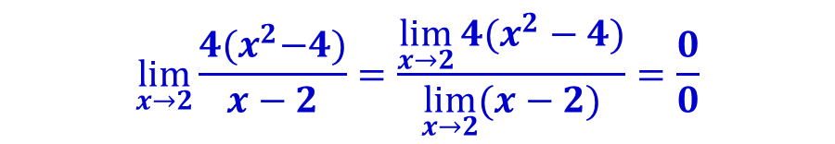

Indeterminate form
$$\lim_{x→2}{\frac{4{(x}^{2}−4)}{x−2}}$$
Consider which we evaluated earlier for the train example by looking at values for x near x = 2.
If we attempt to evaluate this expression by applying Theorem 1- properties 5, we get:
In this case we say that the limit of the quotient f(x)/g(x) as x approaches 2 has the indeterminate form 0/0.
This expression does not provide us with a solution to our problem.
$$\lim_{x→2}{\frac{4{(x}^{2}−4)}{x−2}=\frac{\lim_{x→2}{4(x^{2}−4)}}{\lim_{x→2}{(x−2)}}=\frac{0}{0}}$$

Slide 20
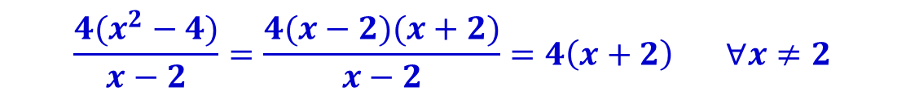

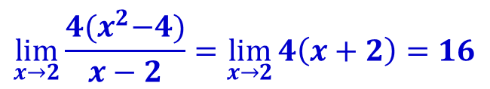
Indeterminate form
Strategy for Evaluating Indeterminate Forms
Consider we have an indeterminate form 0/0.
Thus,
Replace the given function with an appropriate one that takes on the same values as the original function everywhere except at x = a.
Evaluate the limit of this function as x approaches a.
$$\lim_{x→2}{\frac{4{(x}^{2}−4)}{x−2}}$$
$$\frac{4(x^{2}−4)}{x−2}=\frac{4(x−2)(x+2)}{x−2}=4\left(x+2\right) ∀x≠2$$
$$\lim_{x→2}{\frac{4{(x}^{2}−4)}{x−2}}=\lim_{x→2}{4\left(x+2\right)=16}$$

Slide 21

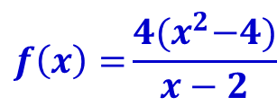
Indeterminate form
Notice in the graphs below that the two functions yield the same graphs, except for the value x = 2:
$$f\left(x\right)={\frac{4{(x}^{2}−4)}{x−2}}$$
y
y
$$g\left(x\right)={4(x+2)}$$
20
16
12
8
4
20
16
12
8
4
x
x
– 3 – 2 – 1 1 2 3
– 3 – 2 – 1 1 2 3

Slide 22
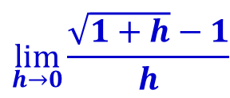

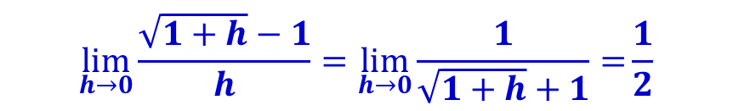
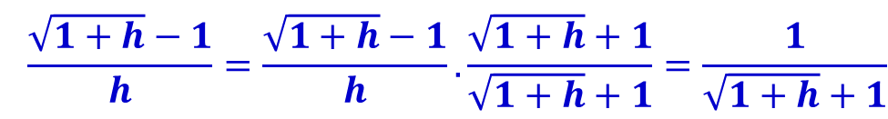
Indeterminate form : Example
$$\lim_{h→0}{\frac{\sqrt{1+h}−1}{h}}$$
Consider we have an indeterminate form 0/0.
With $h≠0$ we can rewrite:
Thus,
$${\frac{\sqrt{1+h}−1}{h}=\frac{\sqrt{1+h}−1}{h}.\frac{\sqrt{1+h}+1}{\sqrt{1+h}+1}=\frac{1}{\sqrt{1+h}+1}}$$
$$\lim_{h→0}{\frac{\sqrt{1+h}−1}{h}}=\lim_{h→0}{\frac{1}{\sqrt{1+h}+1}=}\frac{1}{2}$$

Slide 23
Limit at infinity

Slide 24


Limit at infinity
There are occasions when we want to know whether f(x) approaches a unique number as x increases without bound.
In the graph below, as x increases without bound, f(x) approaches the number 400.
We call the line y = 400 a horizontal asymptote.
In this case, we can say that and we call this a limit of a function at infinity.
y
$$f(x)$$
400
300
200
100
$$\lim_{x→∞}{f(x)}=400$$
x
10 20 30 40 50 60

Slide 25


Limit at infinity : Example
$$f\left(x\right)={\frac{2x^{2}}{1+x^{2}}}$$
Consider Determine what happens to f(x) as x gets larger and larger.
Solution:
We can pick a sequence of values of x and substitute them in the function to obtain the following values:
As x gets larger and larger, f(x) gets closer and closer to 2.
Thus,
x | 1 | 2 | 5 | 10 | 100 | 1000
f(x) | 1 | 1.6 | 1.92 | 1.98 | 1.9998 | 1.999998
$$\lim_{x→∞}{\frac{2x^{2}}{1+x^{2}}}=2$$

Slide 26
Limit at infinity: Definition (An informal view)
The function f has the limit L as x increases without bound (as x approaches infinity), written if f(x) can be made arbitrarily close to L by taking x large enough.
Similarly, the function f has the limit M as x decreases without bound (as x approaches negative infinity), written if f(x) can be made arbitrarily close to M by taking x large enough in absolute value.
$$\lim_{x→∞}{f(x)}=L$$
$$\lim_{x→−∞}{f(x)}=M$$

Slide 27


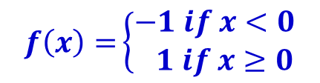



Limit at infinity : Example
$$f\left(x\right)=\left\{\begin{aligned}−1 if x<0 \\ 1 if x≥0\end{aligned}\right.$$
Consider Evaluate and
Solution:
The graph of f(x) shows that
$$\lim_{x→∞}{f(x)}$$
$$\lim_{x→−∞}{f(x)}$$
y
$$\lim_{x→∞}{f\left(x\right)=1}$$
$${f(x)}$$
1
– 1
$$\lim_{x→−∞}{f\left(x\right)}=−1$$
x
– 3 3

Slide 28




Limit at infinity : Example
$$f\left(x\right)={\frac{1}{x^{2}}}$$
Consider Evaluate and
Solution:
The graph of f(x) shows that
$$\lim_{x→∞}{f(x)}$$
$$\lim_{x→−∞}{f(x)}$$
y
$$\lim_{x→∞}{f\left(x\right)=0}$$
$$f\left(x\right)={\frac{1}{x^{2}}}$$
$$\lim_{x→−∞}{f\left(x\right)}=0$$
x
– 3 – 2 – 1 1 2 3

Slide 29
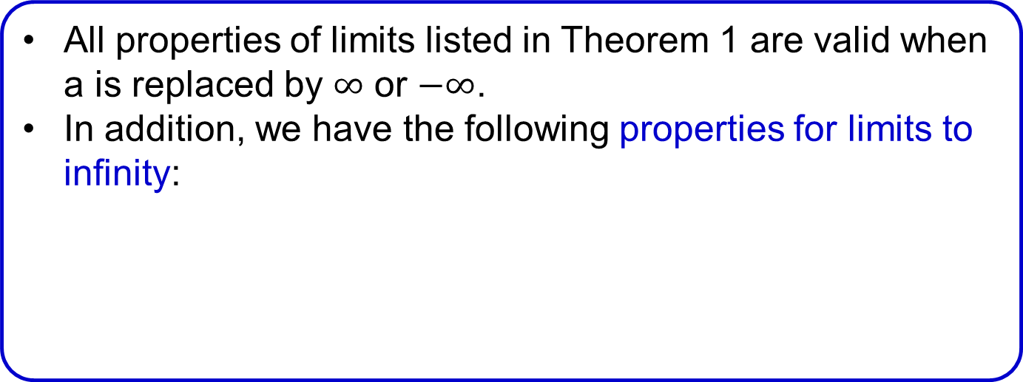
Limit at infinity properties – Theorem 3
All properties of limits listed in Theorem 1 are valid when a is replaced by $∞$ or $−∞$.
In addition, we have the following properties for limits to infinity:
$$For all n>0, \lim_{x→∞}{\frac{1}{x^{n}}}=0 and \lim_{x→−∞}{\frac{1}{x^{n}}=0, provided that \frac{1}{x^{n}} is defined}$$

Slide 30
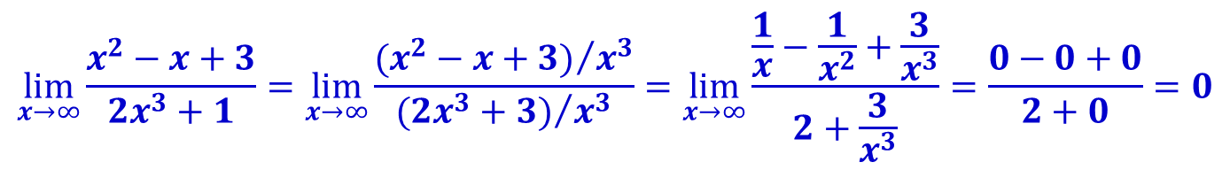
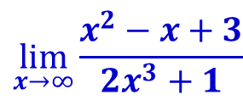
Limit at infinity : Example
Evaluate
Solution:
The limits of both the numerator and denominator do not exist as x approaches infinity, so property 5 is not applicable.
We can find the solution instead by dividing numerator and denominator by x³:
$$\lim_{x→∞}{\frac{x^{2}−x+3}{2x^{3}+1}}$$
$$\lim_{x→∞}{\frac{x^{2}−x+3}{2x^{3}+1}=\lim_{x→∞}{\frac{{(x^{2}−x+3)}/{x^{3}}}{{(2x^{3}+3)}/{x^{3}}}=\lim_{x→∞}{\frac{\frac{1}{x}−\frac{1}{x^{2}}+\frac{3}{x^{3}}}{2+\frac{3}{x^{3}}}=\frac{0−0+0}{2+0}=0}}}$$

Slide 31
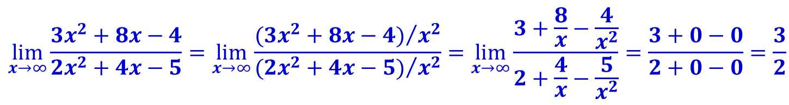
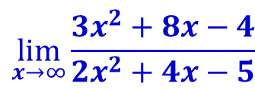
Limit at infinity : Example
Evaluate
Solution:
The limits of both the numerator and denominator do not exist as x approaches infinity, so property 5 is not applicable.
We can find the solution instead by dividing numerator and denominator by x²:
$$\lim_{x→∞}{\frac{{3x}^{2}+8x−4}{2x^{2}+4x−5}}$$
$$\lim_{x→∞}{\frac{{3x}^{2}+8x−4}{2x^{2}+4x−5}=\lim_{x→∞}{\frac{{({3x}^{2}+8x−4)}/{x^{2}}}{{(2x^{2}+4x−5)}/{x^{2}}}=\lim_{x→∞}{\frac{3+\frac{8}{x}−\frac{4}{x^{2}}}{2+\frac{4}{x}−\frac{5}{x^{2}}}=\frac{3+0−0}{2+0−0}=\frac{3}{2}}}}$$

Slide 32
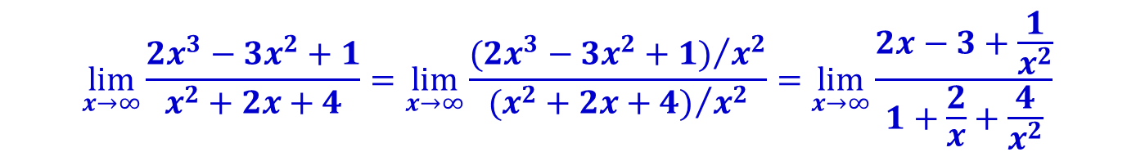
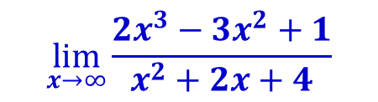
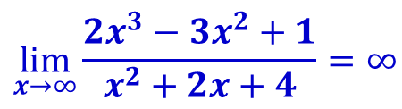
Limit at infinity : Example
Evaluate
Solution:
The limits of both the numerator and denominator do not exist as x approaches infinity, so property 5 is not applicable.
But dividing numerator and denominator by x² does not help in this case
In other words, the limit does not exist.
We indicate this by writing
$$\lim_{x→∞}{\frac{{2x}^{3}−{3x}^{2}+1}{x^{2}+2x+4}}$$
$$\lim_{x→∞}{\frac{{2x}^{3}−3x^{2}+1}{x^{2}+2x+4}=\lim_{x→∞}{\frac{{({2x}^{3}−3x^{2}+1)}/{x^{2}}}{{(x^{2}+2x+4)}/{x^{2}}}=\lim_{x→∞}{\frac{2x−3+\frac{1}{x^{2}}}{1+\frac{2}{x}+\frac{4}{x^{2}}}}}}$$
$$\lim_{x→∞}{\frac{{2x}^{3}−{3x}^{2}+1}{x^{2}+2x+4}=∞}$$

Slide 33
One-sided limit

Slide 34

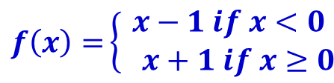
One-sided Limits
$$f\left(x\right)=\left\{\begin{aligned}x−1 if x<0 \\ x+1 if x≥0\end{aligned}\right.$$
Consider
The graph of f(x) shows that f does not have a limit as x approaches zero, because approaching from each side results in different values.
y
$${f(x)}$$
1
– 1
x
– 1 1

Slide 35

One-sided Limits
$$f\left(x\right)=\left\{\begin{aligned}x−1 if x<0 \\ x+1 if x≥0\end{aligned}\right.$$
Consider
If we restrict x to be greater than zero (to the right of zero), we see that f(x) approaches 1 as close to as we please as x approaches 0.
In this case we say that the right-hand limit of f as x approaches 0 is 1, written
y
$${f(x)}$$
1
– 1
x
– 1 1
$$\lim_{x→0^{+}}{f\left(x\right)=1}$$

Slide 36

One-sided Limits
$$f\left(x\right)=\left\{\begin{aligned}x−1 if x<0 \\ x+1 if x≥0\end{aligned}\right.$$
Consider
If we restrict x to be less than zero (to the left of zero), we see that f(x) approaches -1 as close to as we please as x approaches 0.
In this case we say that the left-hand limit of f as x approaches 0 is -1, written
y
$${f(x)}$$
1
– 1
x
– 1 1
$$\lim_{x→0^{−}}{f\left(x\right)=−1}$$

Slide 37
One-sided Limits: Definition
The function f has the right-hand limit L as x approaches from the right, written if the values of f(x) can be made as close to L as we please by taking x sufficiently close to (but not equal to) a and to the right of a.
Similarly, the function f has the left-hand limit M as x approaches from the left, written if the values of f(x) can be made as close to M as we please by taking x sufficiently close to (but not equal to) a and to the left of a.
$$\lim_{x→a^{+}}{f(x)}=L$$
$$\lim_{x→a^{−}}{f(x)}=M$$

Slide 38


One-sided Limits: Theorem 3
The connection between one-side limits and the two-sided limit defined earlier is given by the following theorem.
Let f be a function that is defined for all values of x close to x = a with the possible exception of a itself. Then if and only if
$$\lim_{x→a}{f(x)}=L$$
$$\lim_{x→a^{+}}{f(x)}=\lim_{x→a^{−}}{f\left(x\right)=}L$$

Slide 39

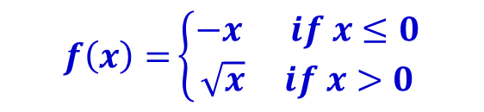

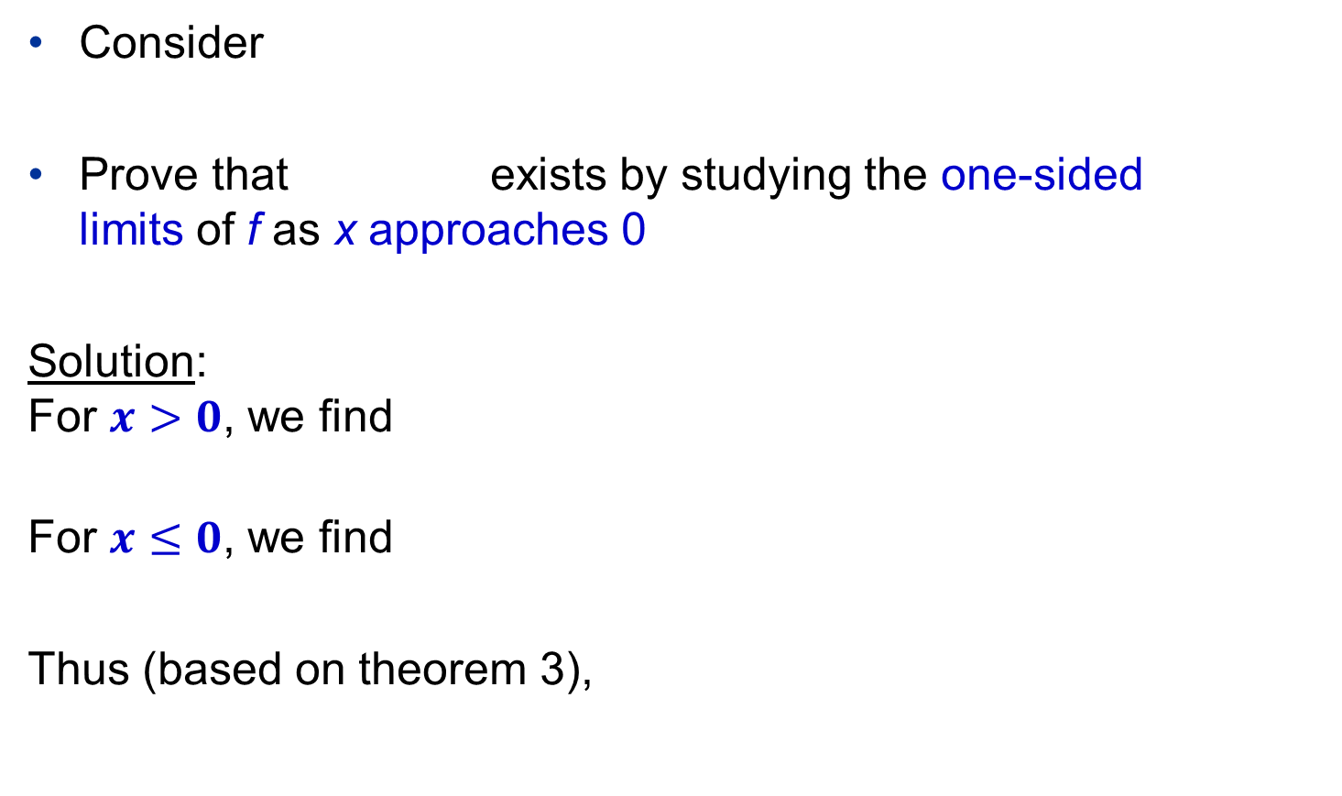



One-sided Limits : Examples
$$f\left(x\right)=\left\{\begin{aligned}−x if x≤0 \\ \sqrt{x} if x>0\end{aligned}\right.$$
Consider
Prove that exists by studying the one-sided limits of f as x approaches 0
Solution: For $x>0$, we find
For $x≤0$, we find
Thus (based on theorem 3),
$$\lim_{x→0}{f\left(x\right)}$$
y
2
1
$$f(x)$$
$$\lim_{x→0^{+}}{f\left(x\right)=0}$$
$$\lim_{x→0^{−}}{f\left(x\right)=0}$$
x
– 2 – 1 1 2
$$\lim_{x→0}{f\left(x\right)=0}$$

Slide 40

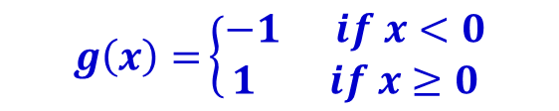





One-sided Limits : Examples
$$g\left(x\right)=\left\{\begin{aligned}−1 if x<0 \\ 1 if x≥0\end{aligned}\right.$$
Consider
Prove that does not exist
Solution: For $x≥0$, we find
For $x<0$, we find
Thus (based on theorem 3), does not exist
$$\lim_{x→0}{g\left(x\right)}$$
y
$$g(x)$$
$$\lim_{x→0^{+}}{g\left(x\right)=1}$$
1
– 1
$$\lim_{x→0^{−}}{g\left(x\right)=−1}$$
x
$$\lim_{x→0}{g\left(x\right)}$$

Slide 41
Continuity of a function

Slide 42
Continuous functions
Loosely speaking, a function is continuous at a given point if its graph at that point has no holes, gaps, jumps, or breaks.
Consider, for example, the graph of f
This function is discontinuous at the following points:
At x = a, f is not defined (x = a is not in the domain of f ).
y
x
a

Slide 43
Continuous functions
Loosely speaking, a function is continuous at a given point if its graph at that point has no holes, gaps, jumps, or breaks.
Consider, for example, the graph of f
This function is discontinuous at the following points:
At x = b, f(b) is not equal to the limit of f(x) as x approaches b
y
x
a
b

Slide 44
Continuous functions
Loosely speaking, a function is continuous at a given point if its graph at that point has no holes, gaps, jumps, or breaks.
Consider, for example, the graph of f
This function is discontinuous at the following points:
At x = c, the function does not have a limit, since the left-hand and the right-hand limits are not equal
y
x
a
b
c

Slide 45
Continuous functions
Loosely speaking, a function is continuous at a given point if its graph at that point has no holes, gaps, jumps, or breaks.
Consider, for example, the graph of f
This function is discontinuous at the following points:
At x = d, the function does not have a limit, resulting a break in the graph
y
x
a
b
c
d

Slide 46


Continuity of a function at a point
A function f is continuous at a point x=a if the following conditions are satisfied:
f(a) is defined
exists
If f is not continuous at x = a, then f is said to be discontinuous at x = a.
Also, f is continuous on an interval if f is continuous at every number in the interval.
$$\lim_{x→a}{f(x)}$$
$$\lim_{x→a}{f\left(x\right)=f(a)}$$

Slide 47
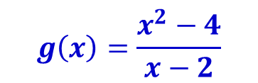

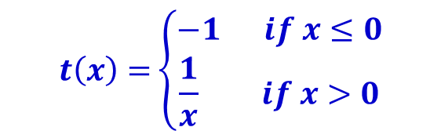
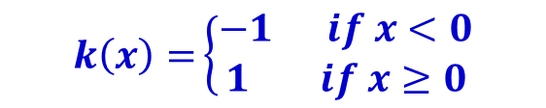
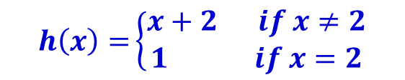
Continuity of a function: Example
Find the values of x for which the function is continuous?
$$f\left(x\right)=x+2$$
$$h\left(x\right)=\left\{\begin{aligned}x+2 if x≠2 \\ 1 if x=2\end{aligned}\right.$$
$$g\left(x\right)=\frac{x^{2}−4}{x−2}$$
$$k\left(x\right)=\left\{\begin{aligned}−1 if x<0 \\ 1 if x≥0\end{aligned}\right.$$
$$t\left(x\right)=\left\{\begin{aligned}−1 if x≤0 \\ \frac{1}{x} if x>0\end{aligned}\right.$$

Slide 48
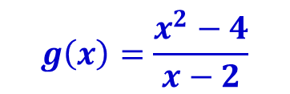

Continuity of a function: Example
Solution:
$$g\left(x\right)=\frac{x^{2}−4}{x−2}$$
y
$$f\left(x\right)=x+2$$
y
5
4
3
2
1
5
4
3
2
1
x
x
– 2 – 1 1 2
– 2 – 1 1 2
The function f is continuous everywhere because the three conditions for continuity are satisfied for all values of x.
The function g is discontinuous at x=2 because g is not defined at that point. g is continuous everywhere else.

Slide 49




Continuity of a function: Example
Solution:
$$y=h(x)$$
y
y
5
4
3
2
1
$$y=k(x)$$
1
– 1
x
x
– 2 – 1 1 2
The function h is discontinuous at x=2 because
h is continuous everywhere else.
The function k is discontinuous at x=0 because does not exist k is continuous everywhere else.
$$h\left(2\right)=1≠\lim_{x→2}{h\left(x\right)=4}$$
$$\lim_{x→0}{k\left(x\right)}$$

Slide 50


Continuity of a function: Example
Solution:
y
$$y=t(x)$$
– 1
x
The function t is discontinuous at x=0 because does not exist. t is continuous everywhere else.
$$\lim_{x→0}{t\left(x\right)}$$

Slide 51

Properties of Continuous Function
The constant function f(x) = c is continuous everywhere.
The identity function f(x) = x is continuous everywhere.
If f and g are continuous at x = a, then
, where n is a real number, is continuous at x = a whenever it is defined at that number.
f ± g is continuous at x = a.
fg is continuous at x = a.
f /g is continuous at g(a) ≠ 0.
$${\left[f(x)\right]}^{n}$$

Slide 52
Properties of Continuous Function
Using these properties, we can obtain the following additional properties.
A polynomial function y = P(x) is continuous at every value of x.
A rational function R(x) = p(x)/q(x) is continuous at every value of x where q(x) ≠ 0.

Slide 53
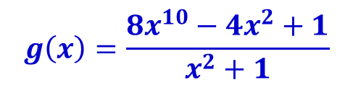

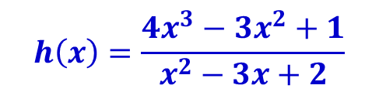
Continuity of a function: Example
Find the values of x for which the function is continuous?
$$f\left(x\right)=3x^{3}+2x^{2}−x+10$$
$$g\left(x\right)=\frac{8x^{10}−4x^{2}+1}{x^{2}+1}$$
$$h\left(x\right)=\frac{4x^{3}−3x^{2}+1}{x^{2}−3x+2}$$

Slide 54
Continuity of a function: Example
Solution:
f(x) is a polynomial function of degree 3, so f(x) is continuous for all values of x.
g(x) is a rational function. Observe that the denominator of g is never equal to zero. Therefore, we conclude that g(x) is continuous for all values of x.
h(x) is a rational function. In this case, however, the denominator of h is equal to zero at x = 1 and x = 2, which we can see by factoring. Therefore, we conclude that h(x) is continuous everywhere except at x = 1 and x = 2.

Slide 55

Intermediate value theorem (Theorem 4)
Let’s look again at the train example.
Recall that the position of the train is a function of time given by f(t) = 4t² for 0 ≤ t ≤ 30. f(t) is continuous for all values of t.
The train cannot vanish at any instant of time and cannot skip portions of track and reappear elsewhere.
y
$$y=f\left(t\right)=4t^{2}$$
s₂
s₃
s₁
t
t₁
t₃
t₂

Slide 56

Intermediate value theorem (Theorem 4)
Recall that the position of the maglev is a function of time given by f(t) = 4t² for 0 ≤ t ≤ 30.
Suppose the position of the train is s1 at some time t1 and its position is s2 at some time t2.
Then, if s3 is any number between s1 and s2, there must be at least one t3 between t1 and t2 giving the time at which the train is at s3 (f(t3) = s3).
y
$$y=f\left(t\right)=4t^{2}$$
s₂
s₃
s₁
t
t₁
t₃
t₂

Slide 57


Intermediate value theorem (Theorem 4)
The Train example carries the gist of the intermediate value theorem:
If f is a continuous function on a closed interval [a, b] and M is any number between f(a) and f(b), then there is at least one number c in [a, b] such that f(c) = M.
y
y
$$y=f\left(x\right)$$
f(b)
M
f(a)
f(b)
M
f(a)
$$y=f\left(x\right)$$
x
x
a
c
b
a
c₁
c₂
c₃
b

Slide 58


Existence of Zeros of a Continuous Function (Theorem 5)
A special case of this theorem is when a continuous function crosses the x axis.
If f is a continuous function on a closed interval [a, b], and if f(a) and f(b) have opposite signs, then there is at least one solution of the equation f(x) = 0 in the interval (a, b).
y
$$y=f\left(x\right)$$
y
f(b)
f(a)
f(b)
f(a)
$$y=f\left(x\right)$$
x
x
a
c
b
a
c₁
c₂
c₃
b

Slide 59

Theorem 5 : Example
$$f\left(x\right)=x^{3}+x+1$$
Let
Prove that the equation f(x)=0 has at least one solution in the interval (-1,1)

Slide 60


Theorem 5 : Example
$$f\left(x\right)=x^{3}+x+1$$
Let
Prove that the equation f(x)=0 has at least one solution in the interval (-1,1)
Solution:
The function f is a polynomial function of degree 3 and is therefore continuous everywhere.
We compute f(-1) and f(1):
Since f (–1) and f (1) have opposite signs, Theorem 5 tells us that the equation f(x)=0 must have at least one solution in the interval (-1,1).
$$f\left(−1\right)={−1}^{3}−1+1=−1$$
$$f\left(1\right)=1^{3}+1+1=3$$

Slide 61
Summary
Describe the behavior of functions as they approach certain x-values.
Definition of limit of a function including one-sided and two-sided limits.
Properties of limit and evaluating the limit of a function graphically, numerically and algebraically.
Indeterminate limit and limit at infinity.
Describe the connection between limits and continuity.

Slide 62
Homework
Problem Set :
Read sections 1.1, 1.2, 1.3, 1.5 in Chapter 1. Test with some exercises at the end of each section (students should do as much as possible)
Read Study guide for topic 2.
All exercises in textbook page 128-129 (chapter 1 review exercise) – except the CAS exercises.
Important exercises in chapter 1 review (page128): 5 -> 20, 26, 27, 31, 32, 35, 36, 37
References
[1] H. Anton, I. Bivens, S. Davis, Calculus - Early Transcendentals, 9th Ed., MA, USA: John Wiley & Sons, Inc., 2009.

